Slide 1
Gannett v. Twp. of Neptune
Common Law Right of Access
New Jersey Press Association
College Awards Luncheon
April 22, 2023

Slide 2
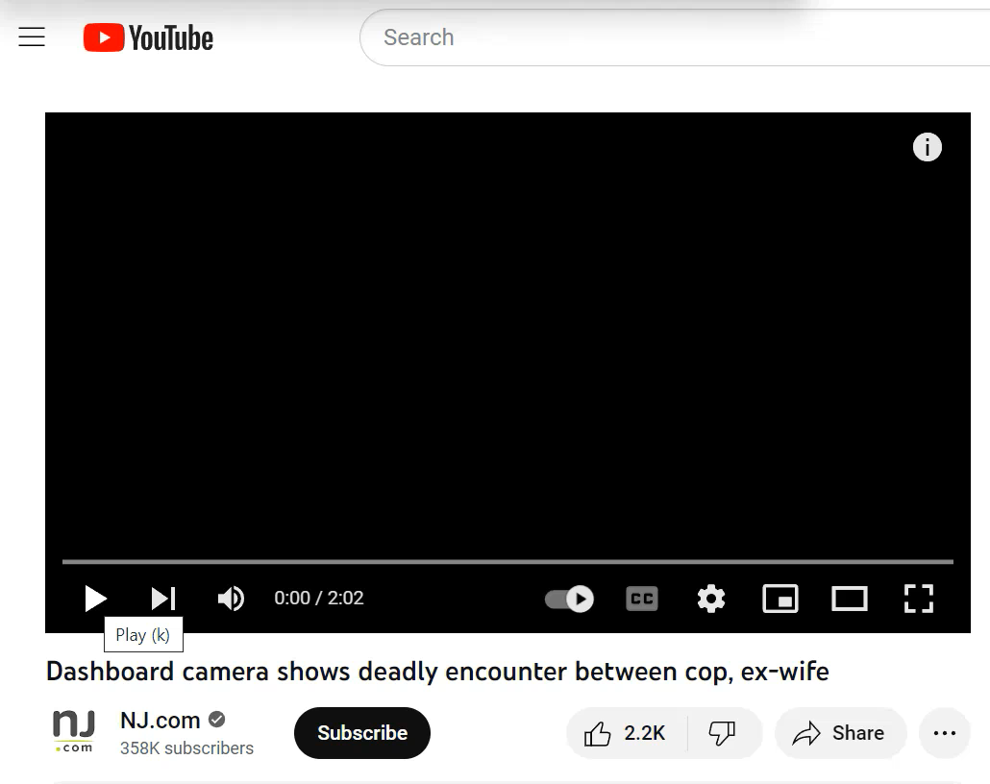
June 16, 2015

Slide 3
Vaughn Index
(A) | (B) | (C) | (D) | (E)
List of all records responsive to Requestor’s OPRA request (include the number of pages for each record). | List of all records provided to Requestor, in their entirety or with redactions (include the date such records were provided). | If records were disclosed with redactions, give a general nature description of the redactions. | If records were denied in their entirety, give a general nature description of the record. | List the legal explanation and statutory citation for the denial of access to records in their entirety or with redactions.
March 27, 1994 Internal Affairs Document – 7 pages. | None. Access was denied. | N/A. | Report and related documents. | Personnel record (47:1A-10) and protected under Internal Affairs guidelines.

Slide 4
IAPP – Confidentiality Provisions
  The nature and source of internal allegations, the progress of internal affairs investigations, and the resulting materials are confidential information. The contents of the internal investigation case files shall be retained in the internal affairs unit and clearly marked as confidential. The information and records of an internal investigation shall only be released under the following limited circumstances:
  administrative charges against an officer and a hearing is held - a copy of all discoverable materials shall be provided to the officer/hearing officer;
  officer/agency/governing jurisdiction is a defendant in a lawsuit arising out of an IA matter, investigative reports may be released to representing attorney;
  upon request/direction of county prosecutor or Attorney General;
  upon Court Order.

Slide 5
Loigman Factors
(1) the extent to which disclosure will impede agency functions by discouraging citizens from providing information to the government;
(2) the effect disclosure may have upon persons who have given such information, and whether they did so in reliance that their identities would not be disclosed;
(3) the extent to which agency self-evaluation, program improvement, or other decision-making will be chilled by disclosure;
(4) the degree to which the information sought includes factual data as opposed to evaluative reports of policymakers;
(5) whether any findings of public misconduct have been insufficiently corrected by remedial measures instituted by the investigative agency; and
(6) whether any agency disciplinary or investigatory proceedings have arisen that may circumscribe the individual's asserted need for the materials.

Slide 6
Relevant Mason Language
“The parties have not addressed at length whether the question of attorney's fees merits different treatment in an action brought under the common law. Absent an apparent, theoretical basis for such a distinction, we conclude that the catalyst theory applies to common law suits as well.”

Slide 7
Additional Rivera Factors
(1) the nature and seriousness of the misconduct.
(2) whether the alleged misconduct was substantiated.
(3) the nature of the discipline imposed.
(4) the nature of the official's position.
(5) the individual's record of misconduct.

